Slide 1


Cheating detection in exam halls using Computer Vision
By: Ahad Omar Alfarsi

Slide 2
Table of contents
01
02
The idea
The dataset
03
04
05
Tools
Training the model
Demo
Slide 4
Slide 6
Slide 8
From Slide 10 to Slide 14
Slide 16 & Slide 17

Slide 3
01
Project Idea

Slide 4
The idea
My project focuses on detecting cheating in exam rooms using AI. The system can analyze either recorded videos or a live camera feed to identify students who are "Cheating" and those who are "Not Cheating". By using computer vision techniques, my project aims to automate the monitoring process, reduce human error, and make exam supervision more efficient and reliable. This tool can help teachers focus on teaching while ensuring exam integrity.

Slide 5
02
The dataset

Slide 6
The dataset
For this project, I downloaded a dataset from Roboflow that contains images labeled as “cheating” and “not cheating”.
The dataset is relatively small, which helps to reduce the training time while still allowing the model to learn the basic patterns.
You can access the dataset through this link:
Cheating-detection-dataset

Slide 7
03
Tools

Slide 8




Tools
Python
YOLO
PyTorch
OpenCV

Slide 9
04
Training the model

Slide 10


Training the model
The model was initially trained on Kaggle, and after training, it was saved and later used for inference on Jupyter Notebook.
Kaggle
Jupyter Notebook

Slide 11
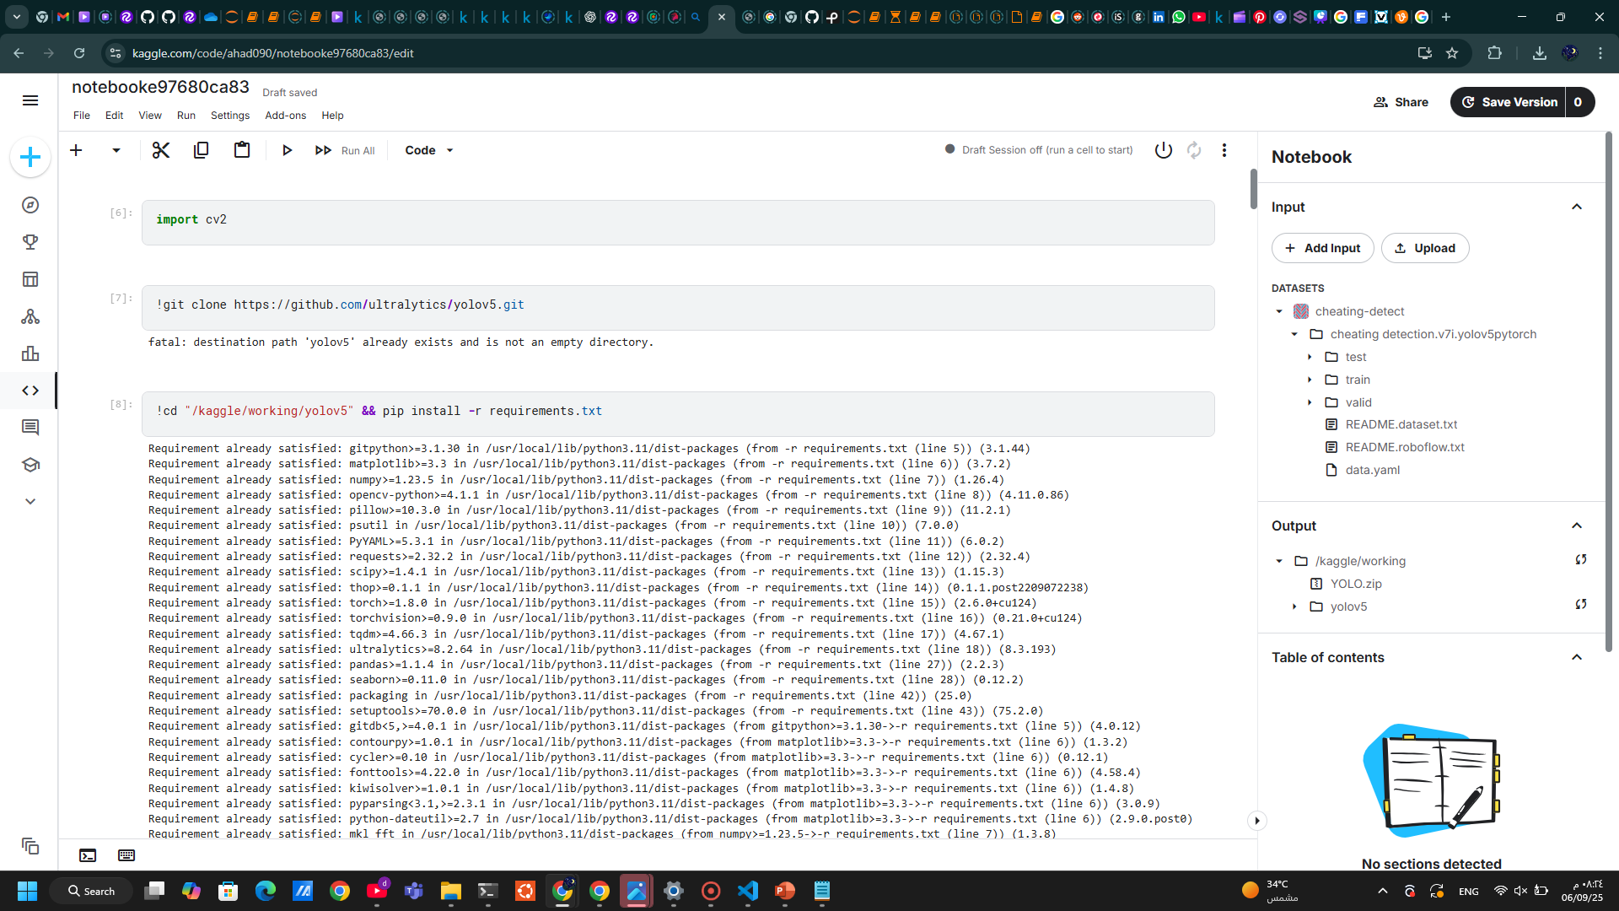
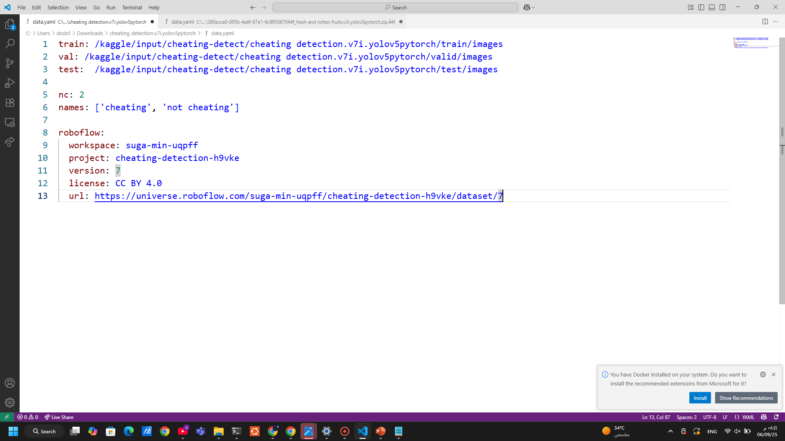
Training the model
First:
I uploaded the dataset
Make sure the yaml file have correct paths

Slide 12
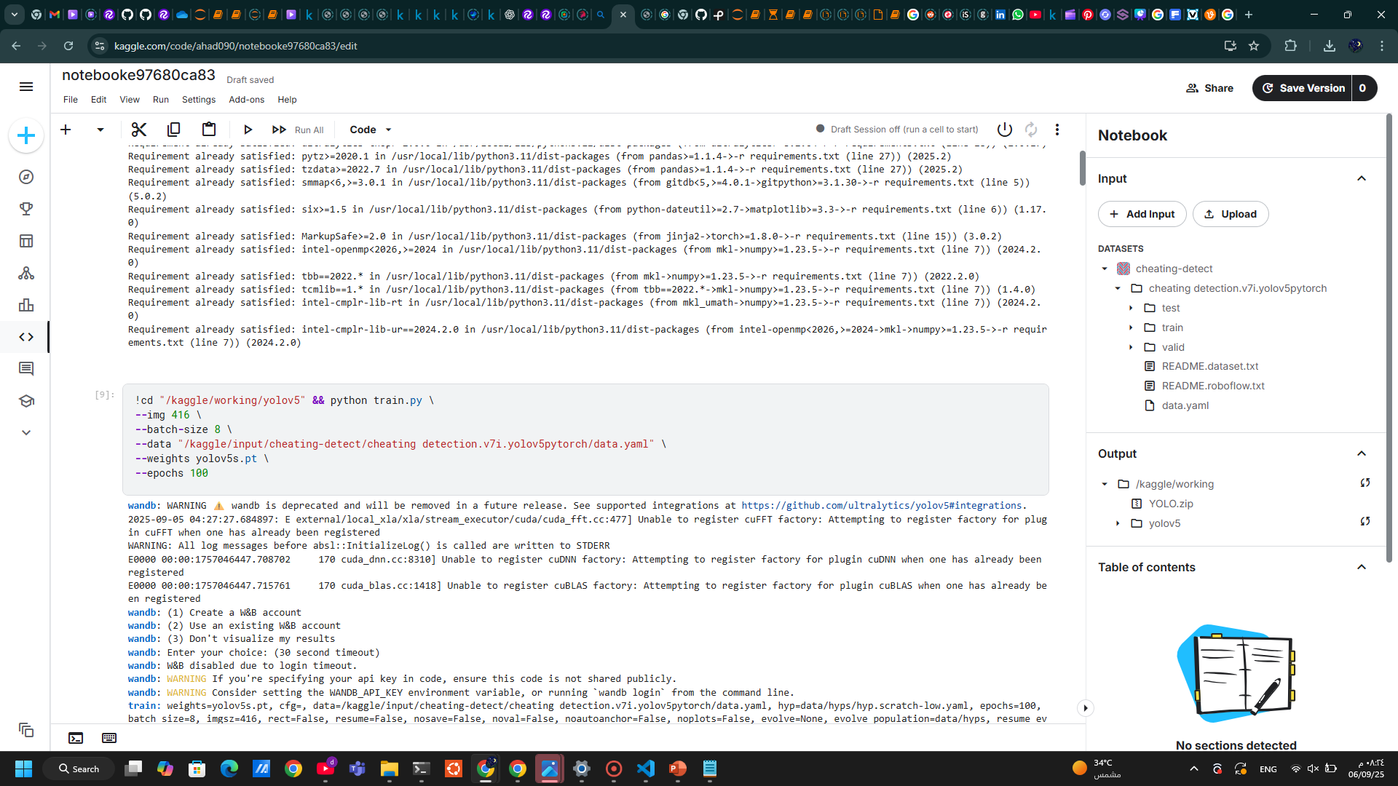
Training the model
Second:
Importing and installing the libraries and the yolo model
Train the model on the yaml file which contain the paths of train, val , test images
Yolov5s → because my dataset is small

Slide 13
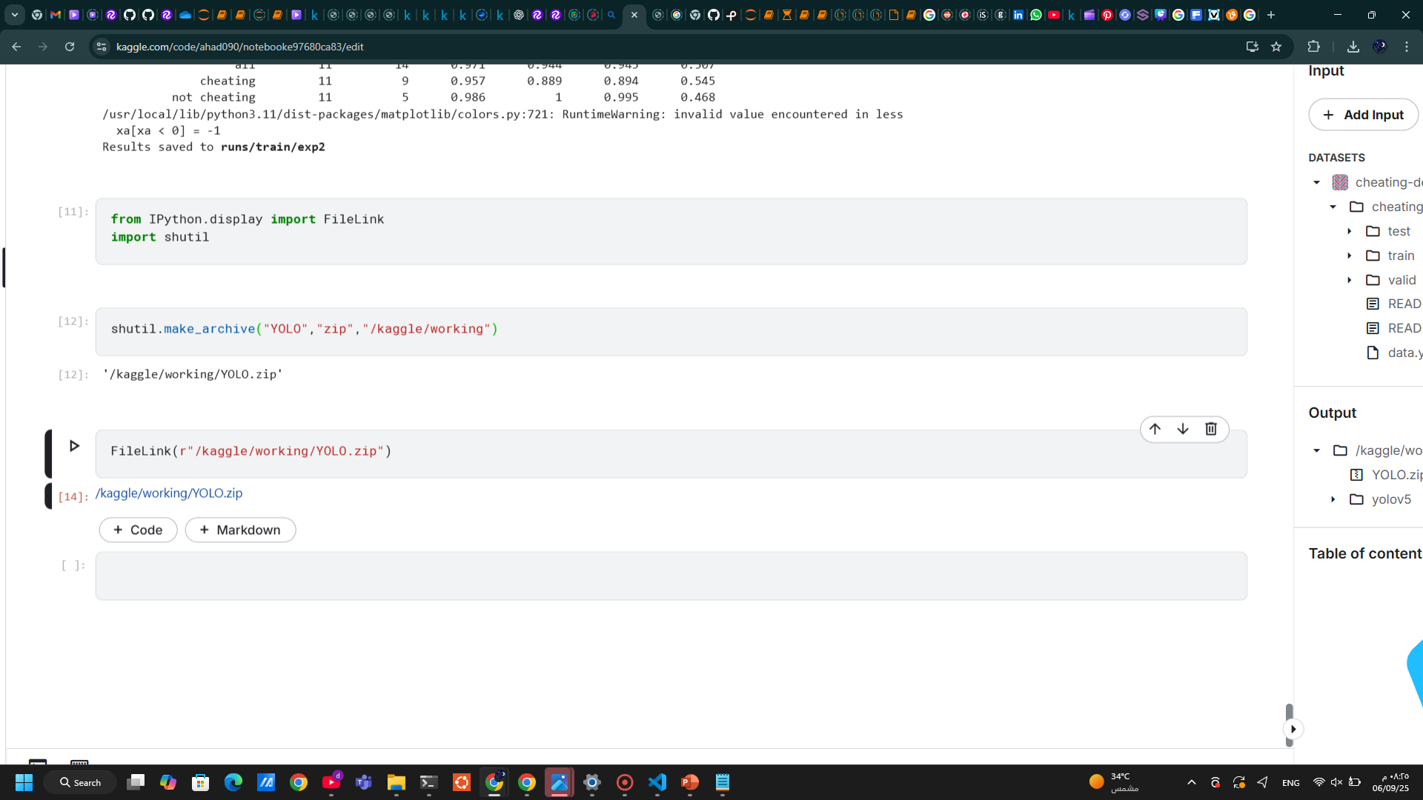
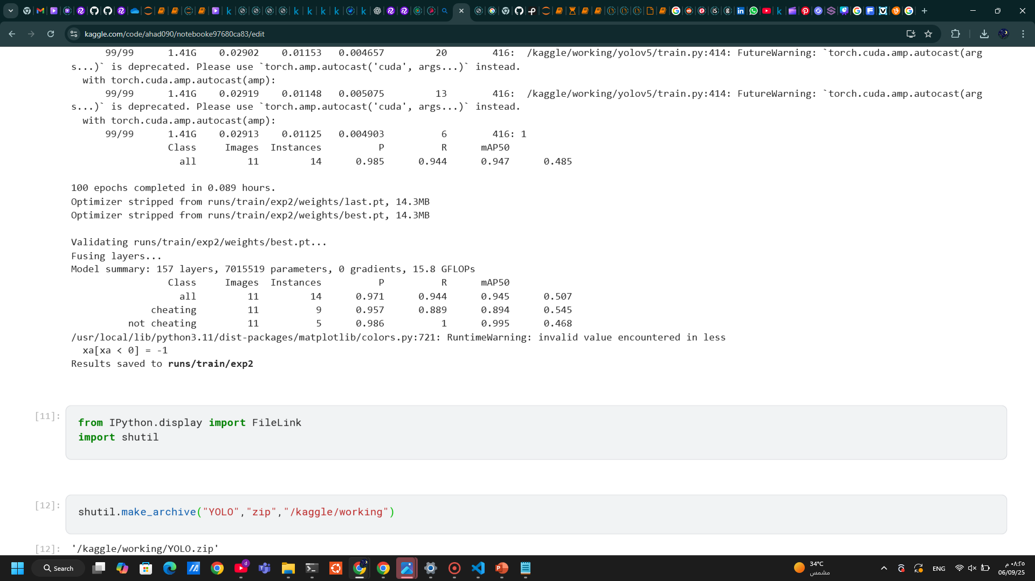
Training the model
Third:
After the train is done, here is the summary of the model
Saving the model

Slide 14
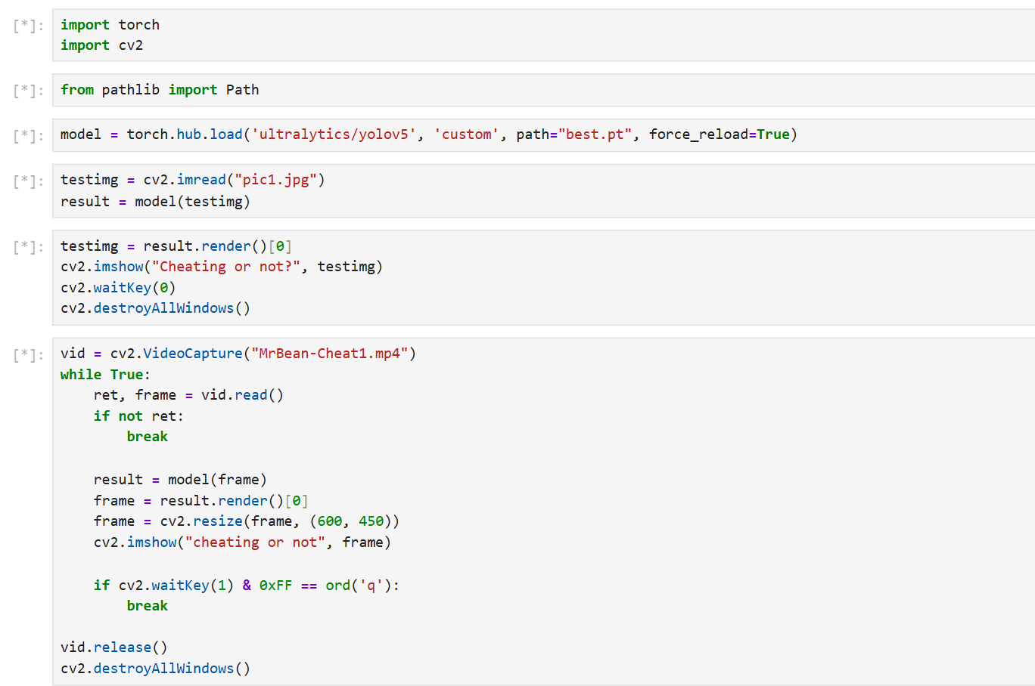
Training the model
Importing the libraries
Load the model and the best.pt from my model file
For images
For Videos

Slide 15
05
Demo

Slide 16
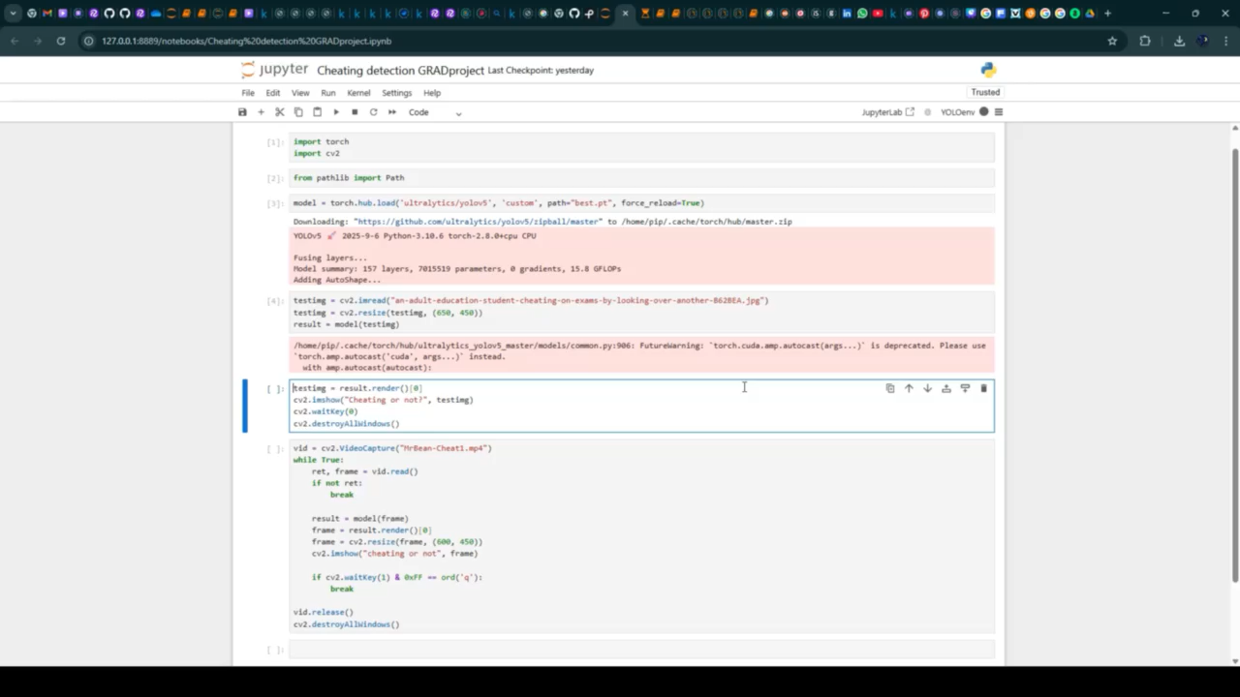
Demo
Train the model on images:
DEMO of three tests

Slide 17
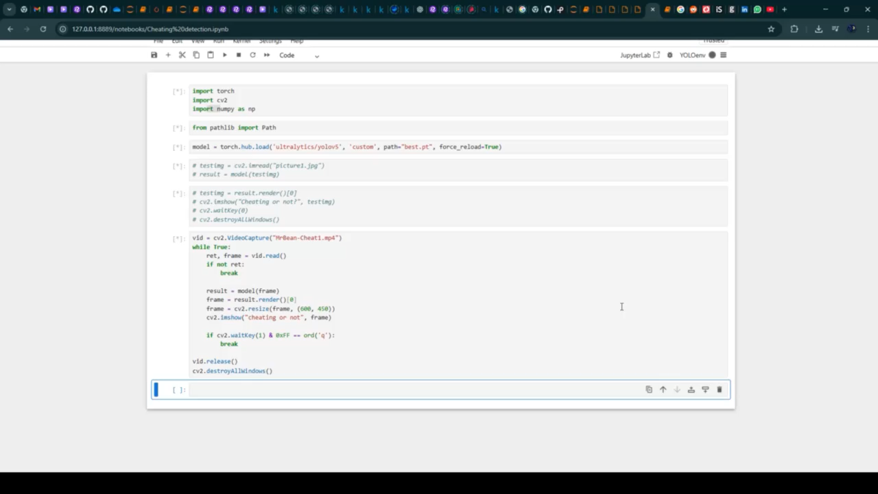
Demo
Train the model on videos:
DEMO of two tests

Slide 18
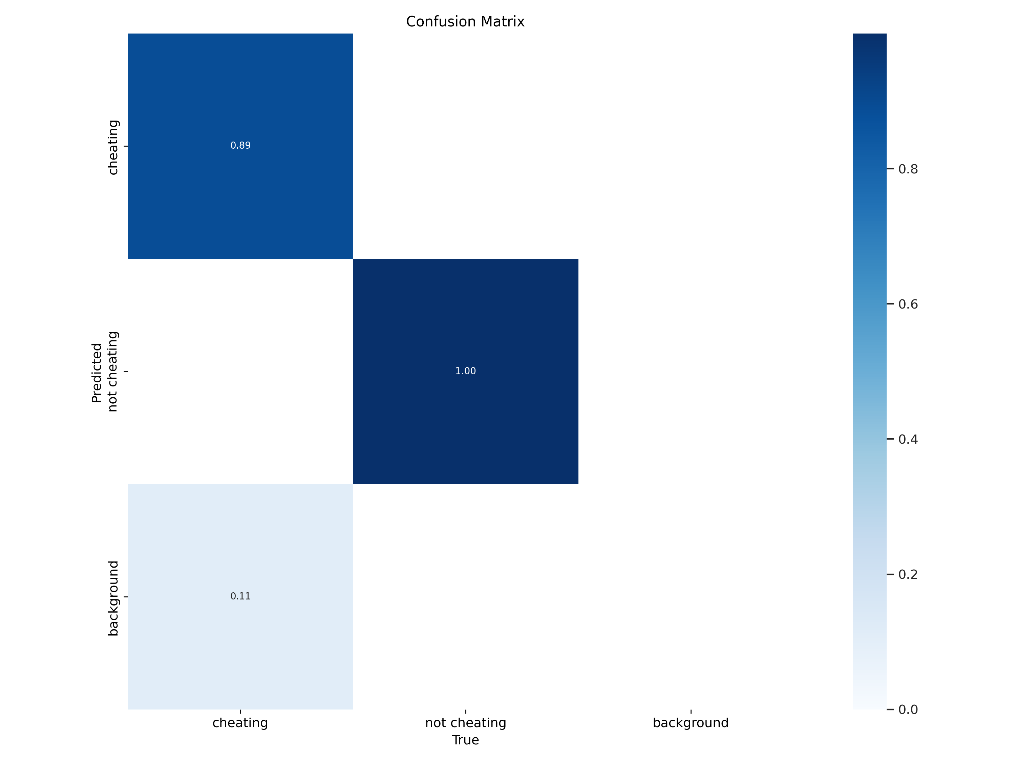
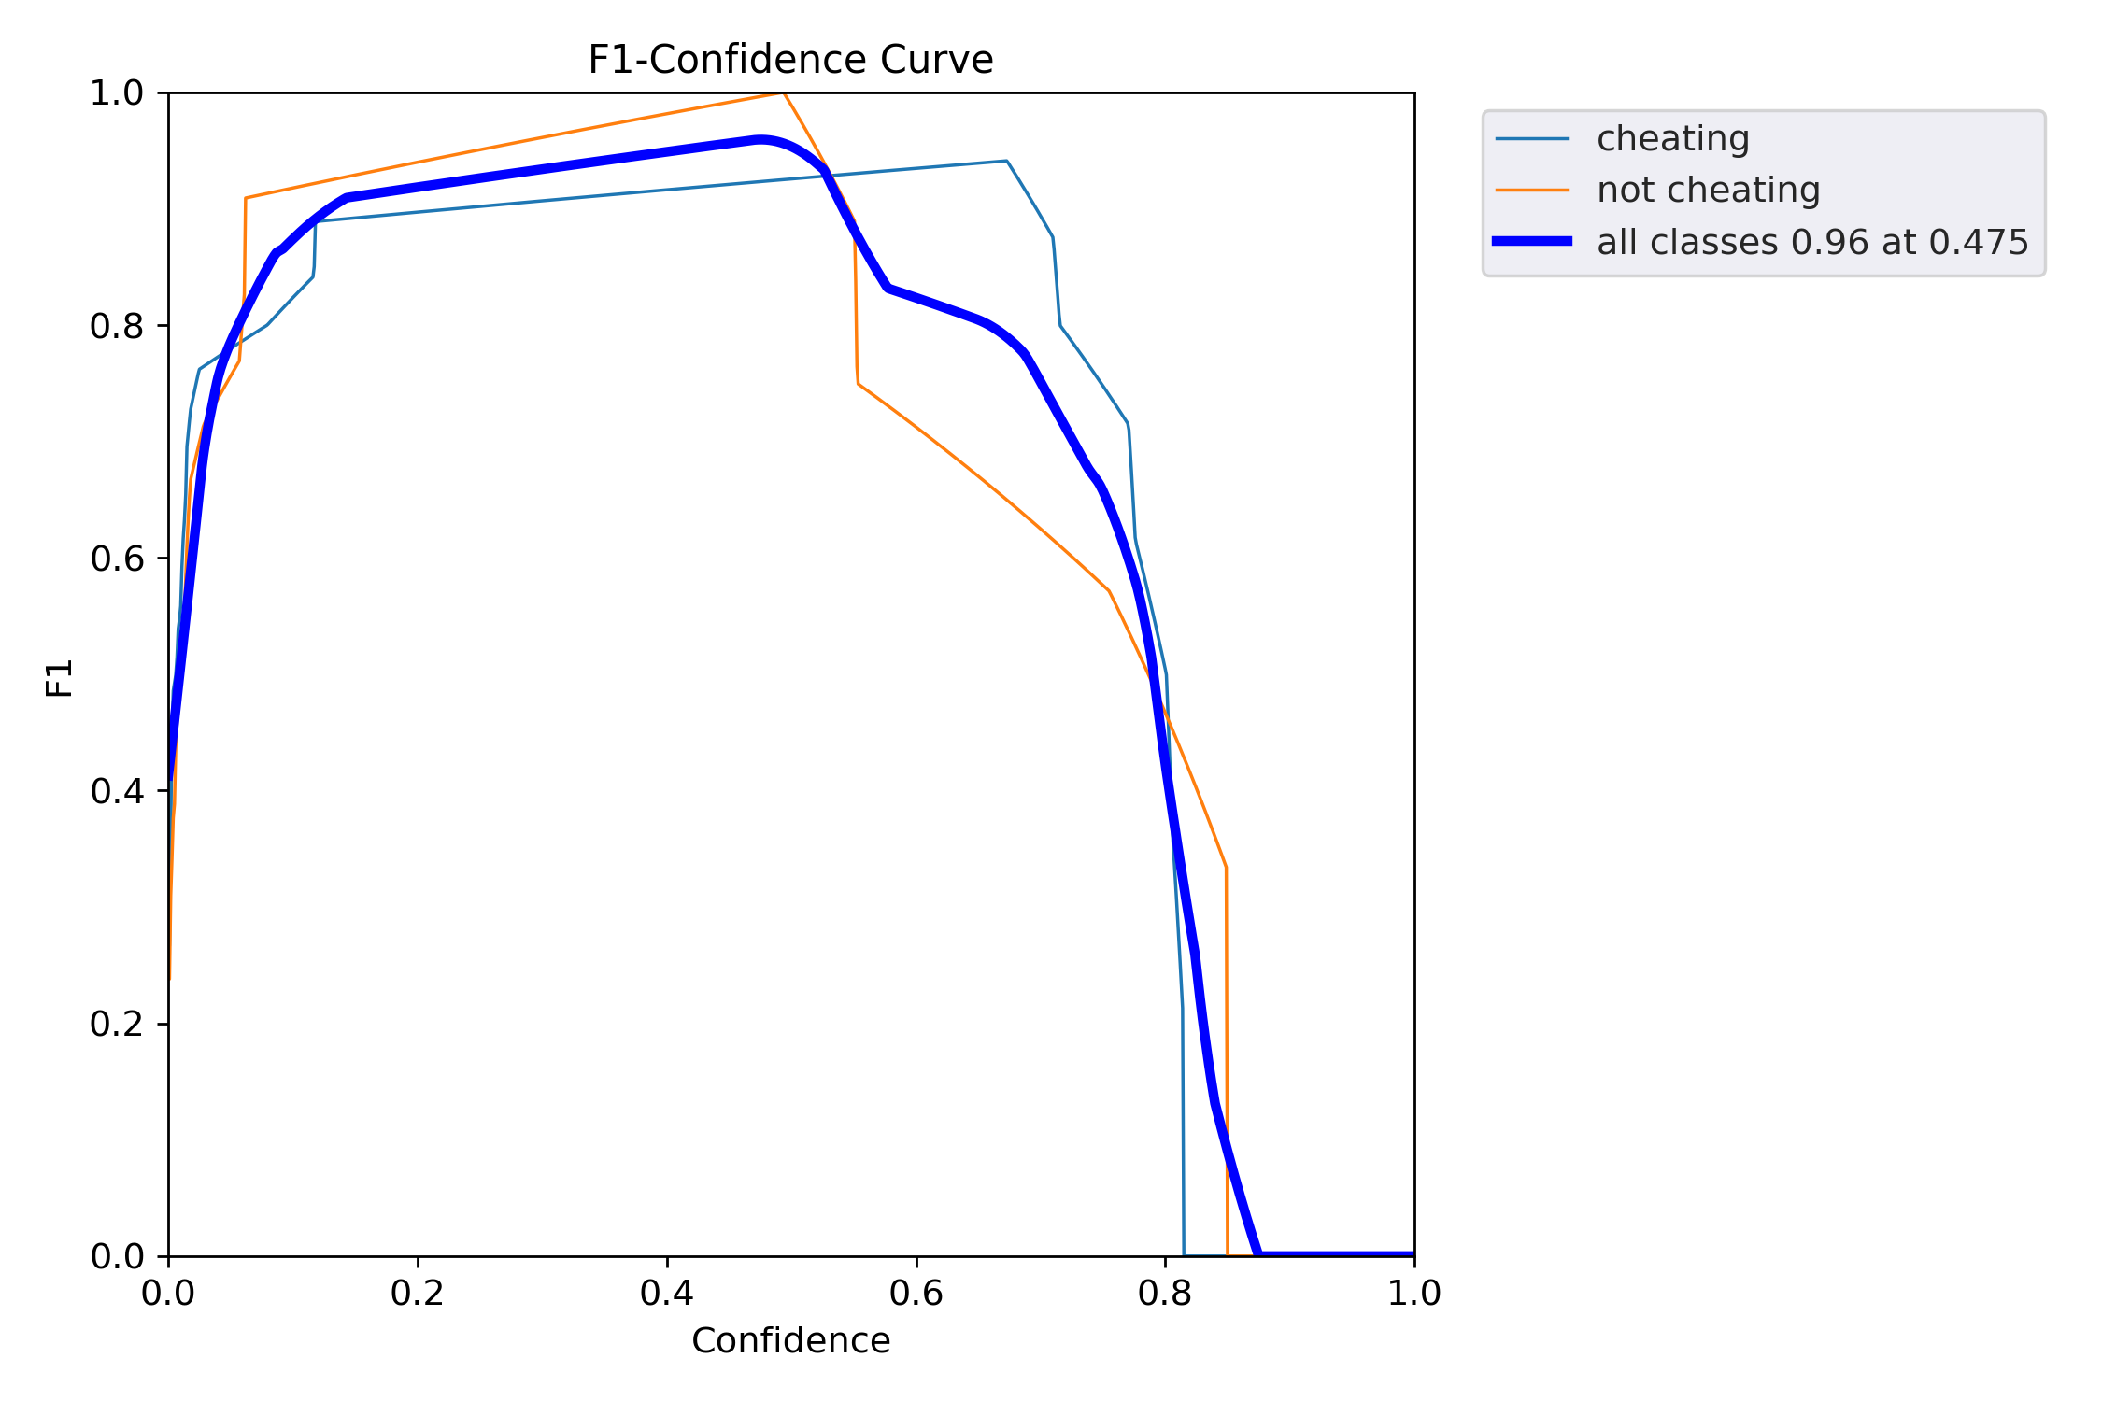
Model Summary
Confusion Matrix
F1 Curve

Slide 19
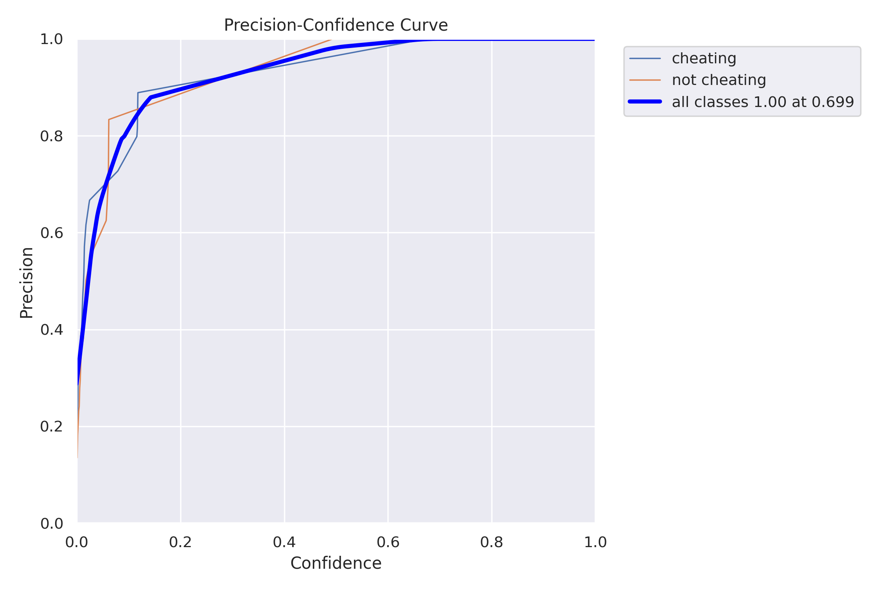
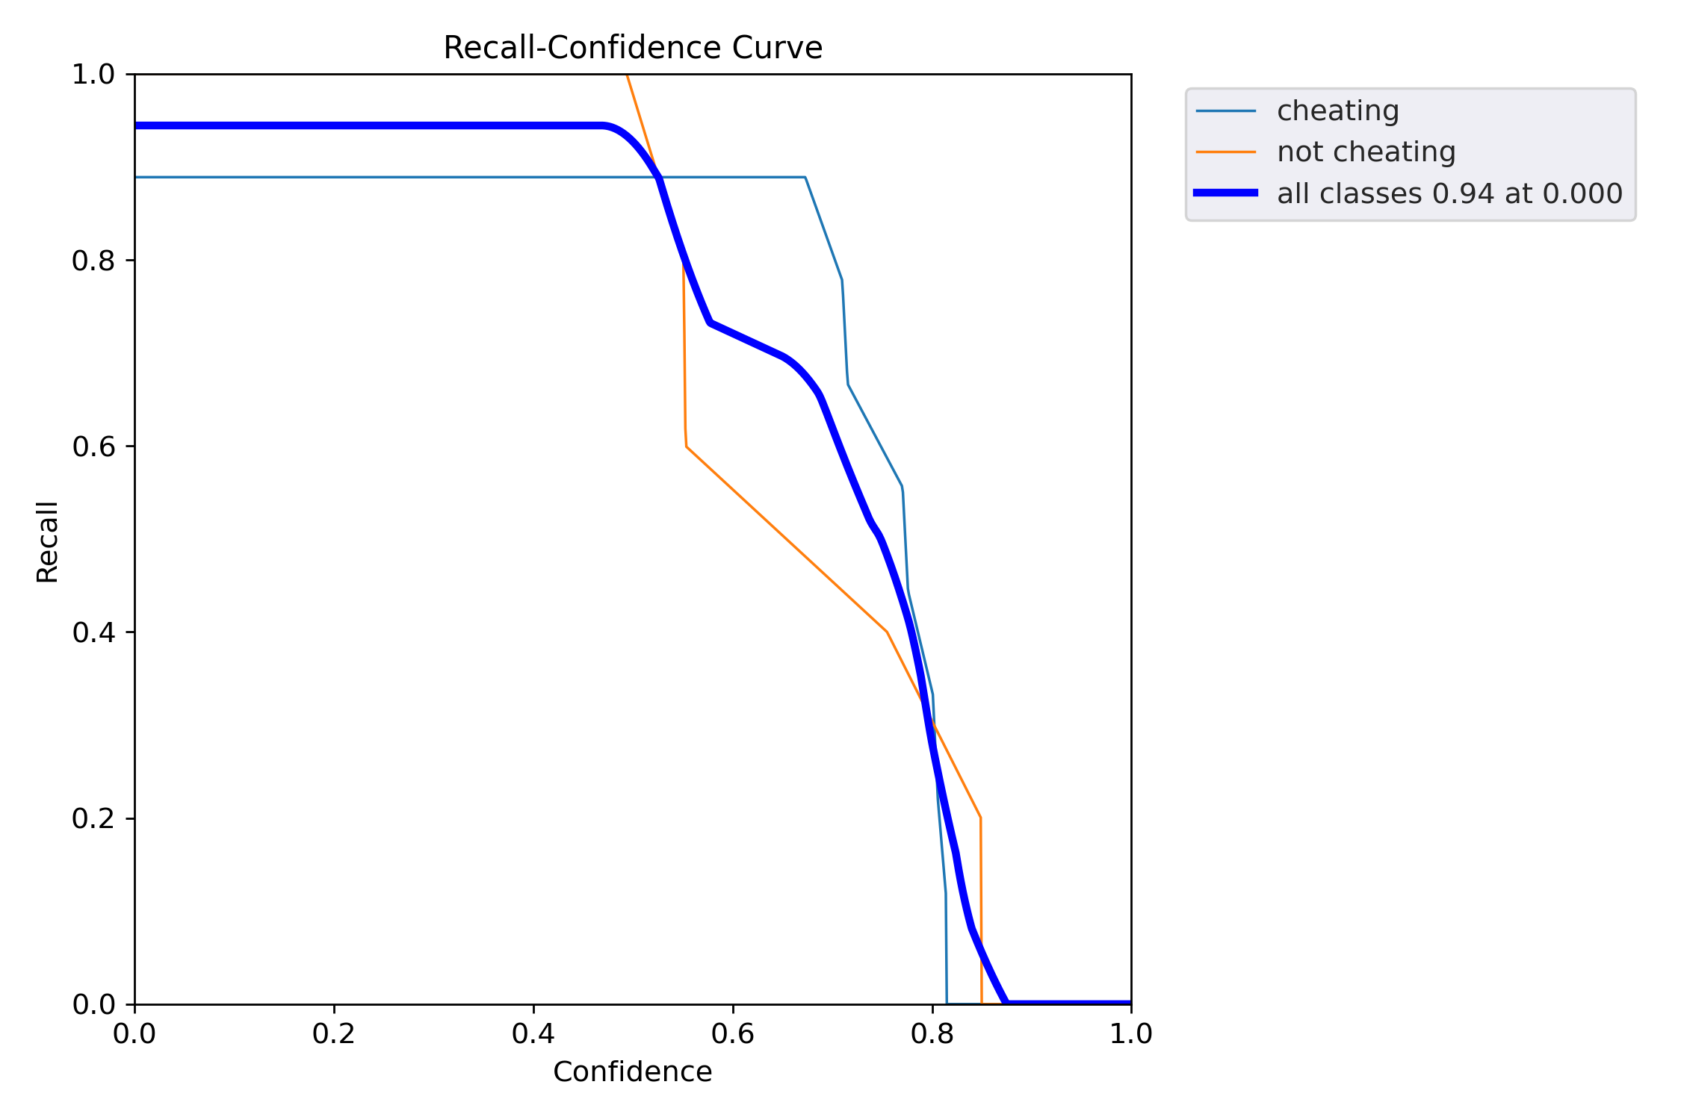
Model Summary
P Curve
R Curve

Slide 20
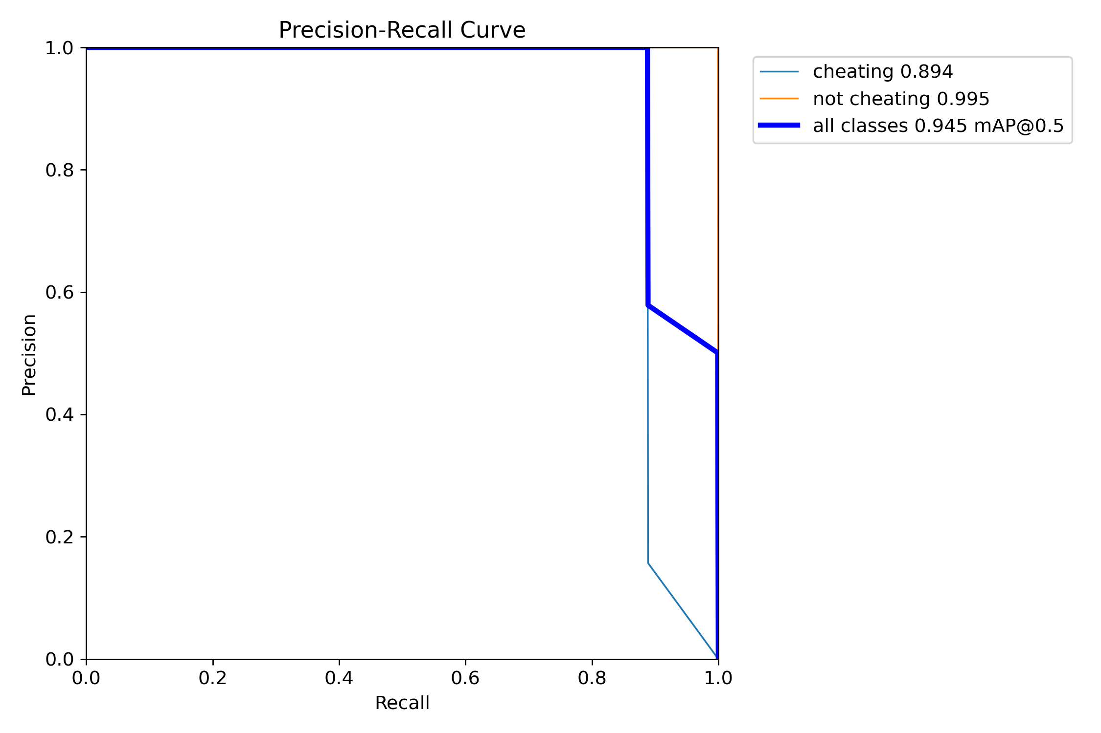
Model Summary
PR Curve

Slide 21
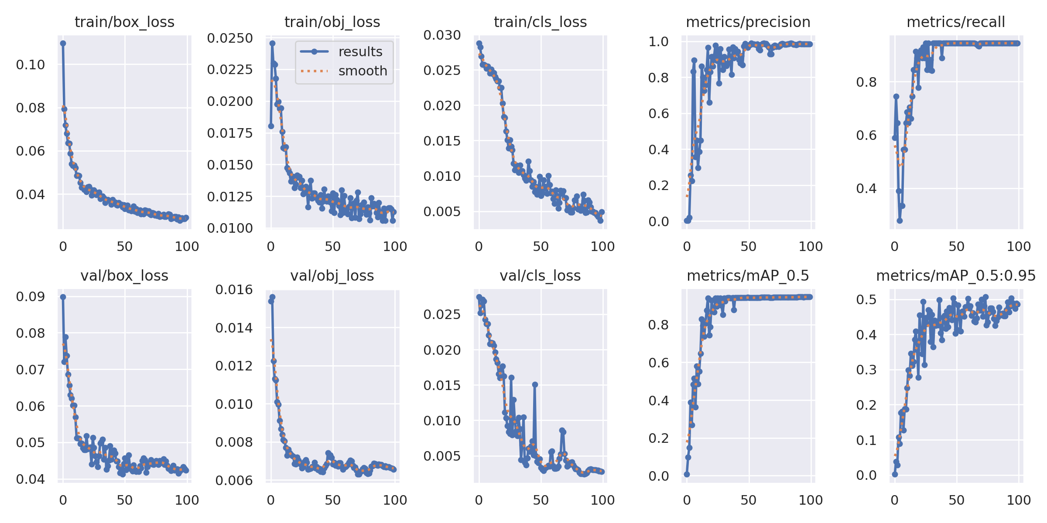
Model Summary
Results

Slide 22
Thank you

